Slide 1
AIRBNB MARKET ANALYTICS-
ZURICH
Vidhi A. Sharma Soham S. Deshkhaire
Boston University | AD699 Data Mining for Business Analytics | Fall 2025

Slide 2
PROJECT OBJECTIVE
Analyse Zurich’s Airbnb listings to understand pricing patterns, host behaviour, and linguistic cues using regression, classification, NLP, and clustering.
Dataset
2,534 listings, 75 variables (InsideAirbnb)
Focus on price, amenities, host data, and review
Key Questions:
What factors influence Airbnb pricing in Zurich?
Do host or text features predict listing performance?
How does the market segment by price and availability?

Slide 3
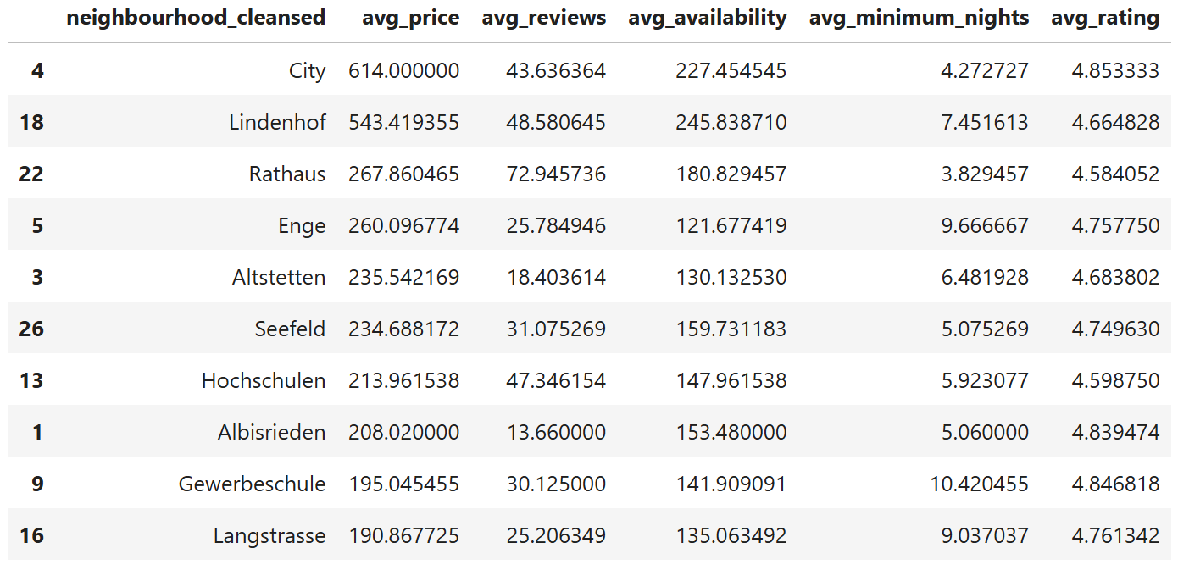
Data Overview
Cleaning & Preparation:
Dropped columns with >80 % missing data
(calendar_updated, id)
Imputed numeric gaps with median; filled text
with “Not provided”
Extracted numeric values from bathrooms_text
Converted price to float (CHF)
Quick Insights
Outlier Note Prices are right-skewed; most listings under 250 CHF with a few luxury outliers above 1000 CHF. These were kept to reflect true market spread.
Average price ≈ 273 CHF
Highest district: Lindenhof (≈540 CHF)
Lowest district: Langstrasse (≈190 CHF)
Average rating: 4.7 / 5

Slide 4
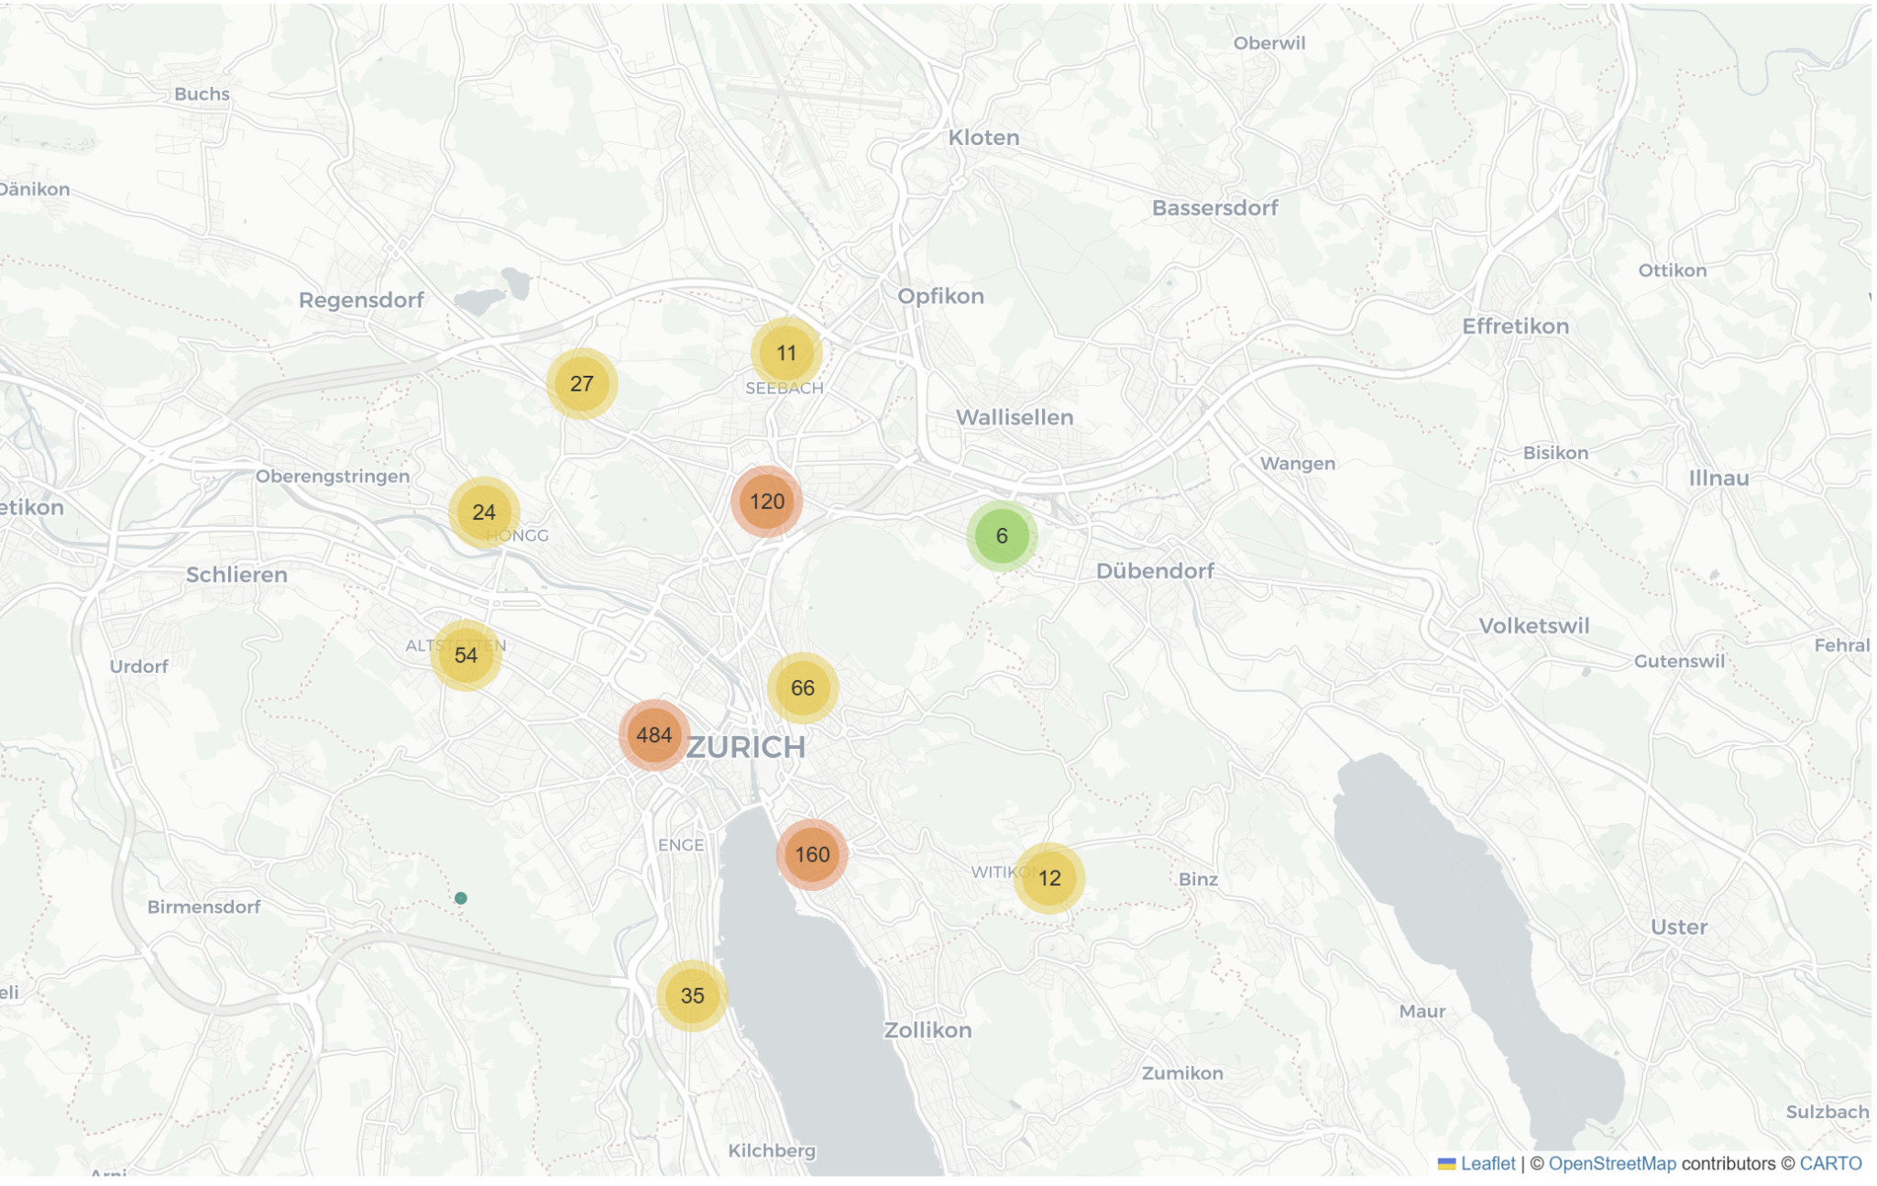
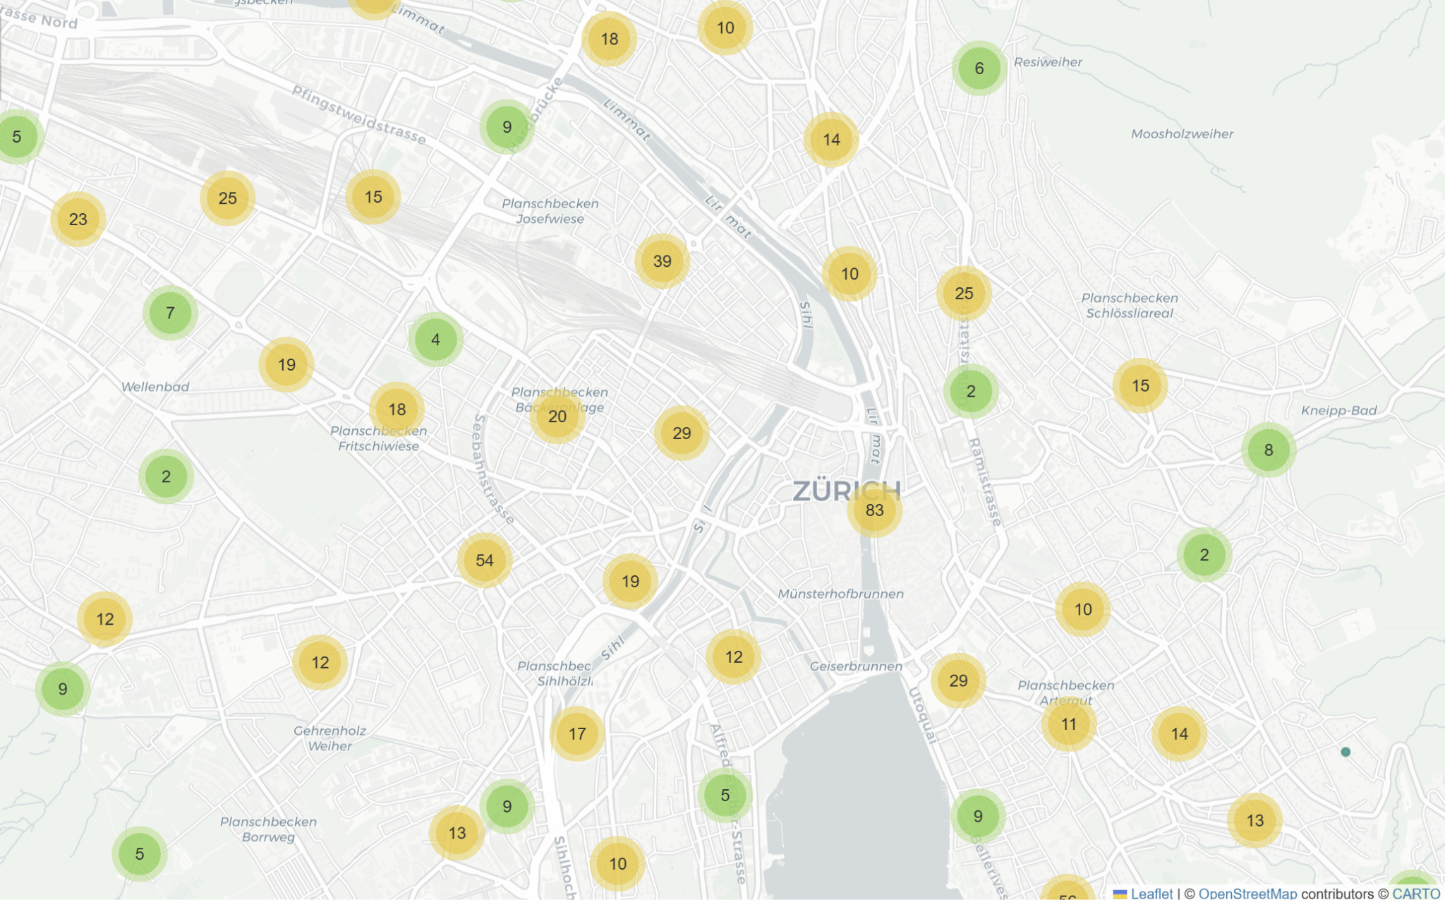
Visual Insights: Folium
Geographic Trends
Listings cluster tightly around the lake and city centre.
Central neighbourhoods show high prices and limited availability.
Suburban listings are more dispersed with lower rates and longer stays.

Slide 5
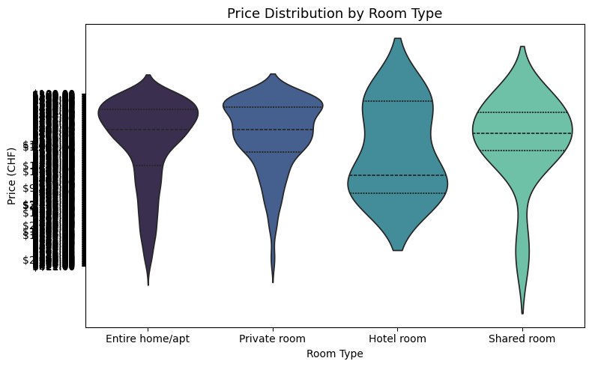
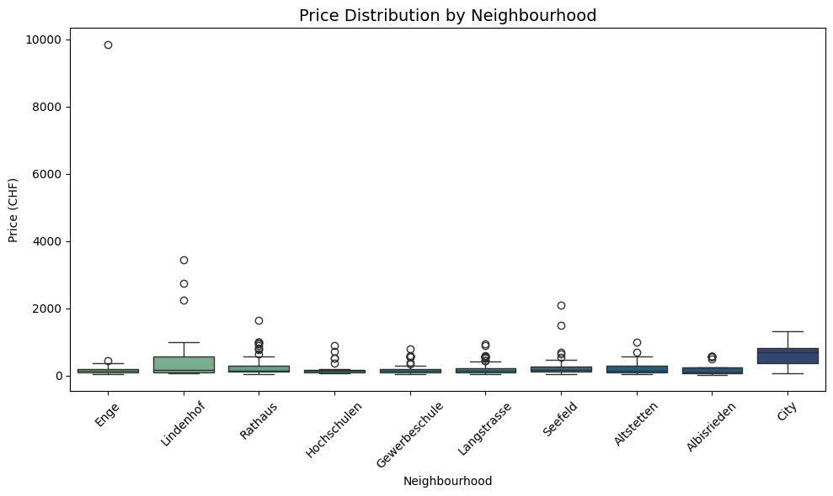
Price and Property Type
Violin plot: entire apartments cost the most, private rooms sit mid-range, shared rooms are lowest.
Boxplot: central areas (City, Lindenhof, Rathaus) dominate the upper range.

Slide 6
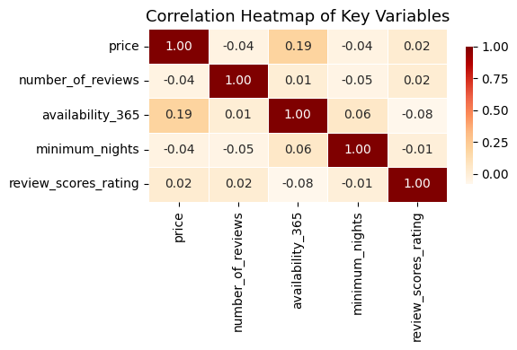
Correlation heatmap shows weak relationships among most variables.
Price shows a mild positive link with availability, suggesting expensive listings stay vacant longer.

Slide 7
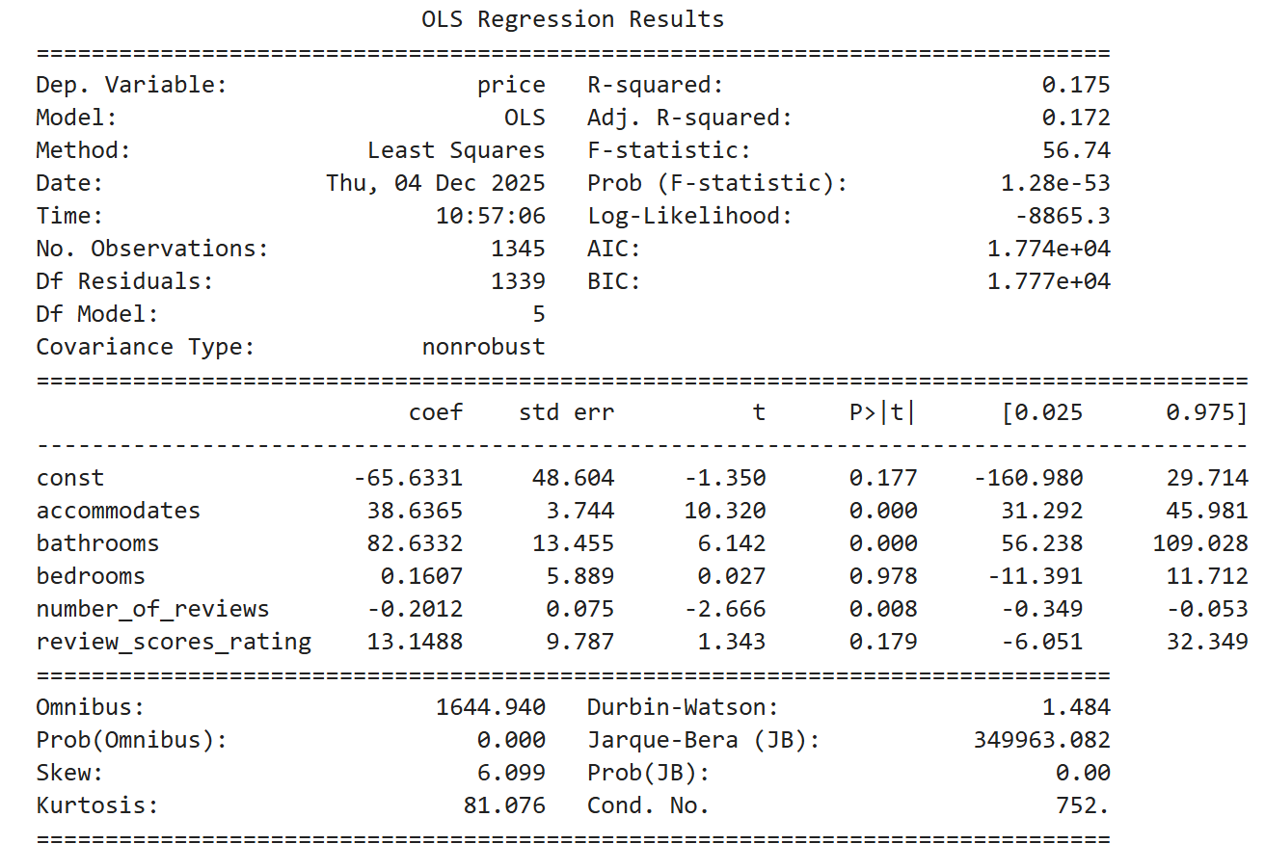
Regression Model-Price Prediction
Goal: Identify which features most strongly affect price.
Top predictors: bathrooms, accommodates, bedrooms
Model explains ~17% of price variation (R² = 0.17)
Each extra bathroom adds ~870 CHF to price.
Ratings had minimal impact.People pay for plumbing, not praise.

Slide 8
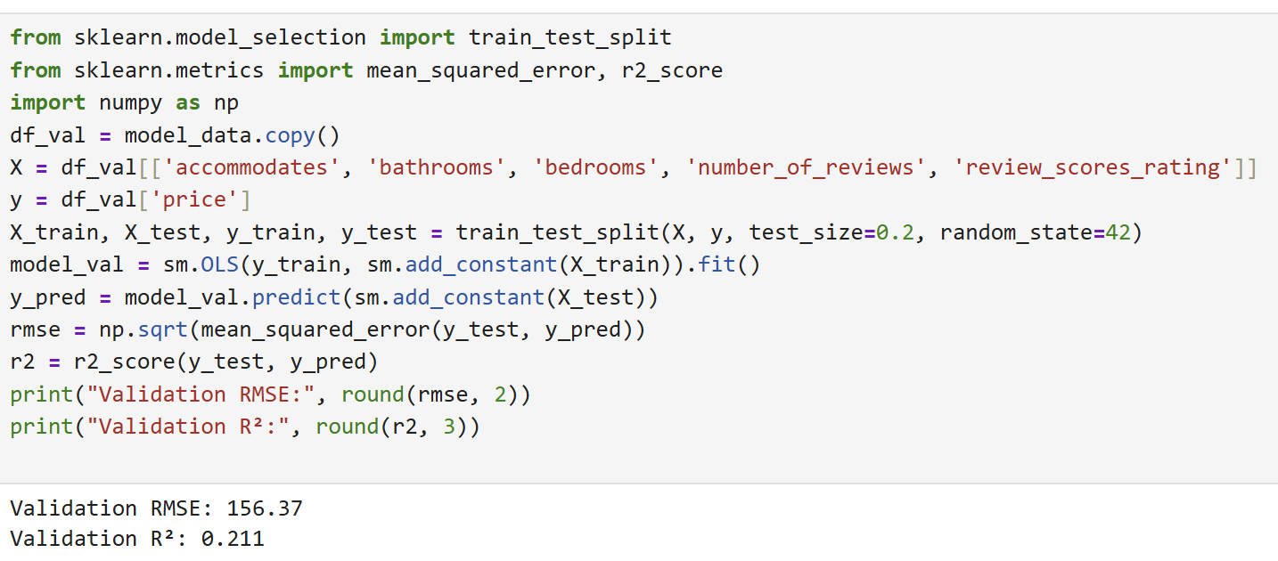
Model Validation
Goal: Prove model reliability beyond training data.
RMSE: 156 CHF
Validation R²: 0.21
Model generalises well; performance is stable and realistic for Zurich’s varied market.
Confirms that structural features drive pricing more than subjective factors.

Slide 9
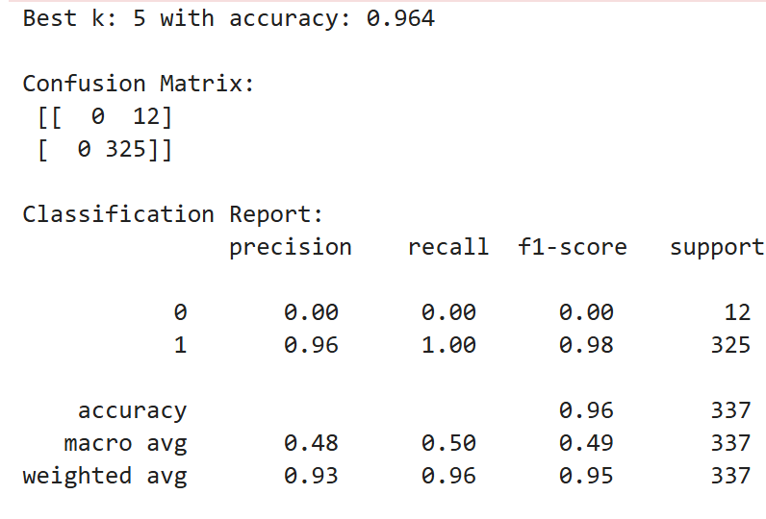
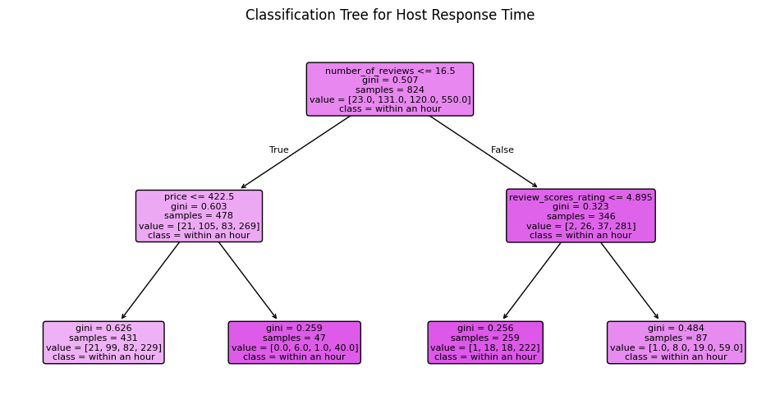
Classification Models
KNN (Wi-Fi Prediction):
Accuracy: 96% (k = 5)
Strong result shows Wi-Fi presence is nearly universal.
Decision Tree (Host Response Time):
Accuracy: 62%
Price and review count are key predictors.
New/mid-priced hosts reply faster; established
ones take longer.

Slide 10
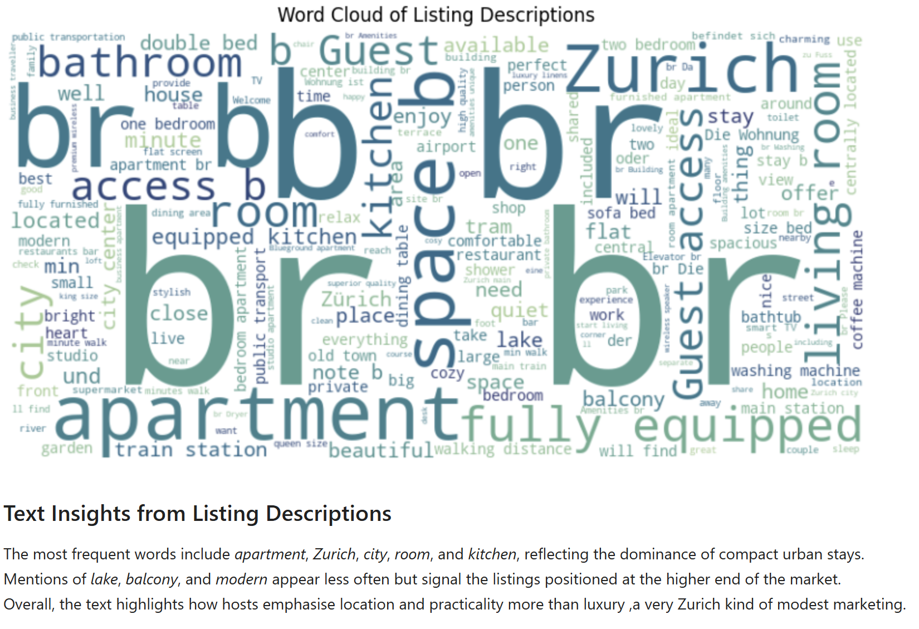
NLP Model
Goal: Predict price quartile using text features (DistilBERT).
Accuracy: 37% (low but insightful).
“Modern,” “central,” and “balcony” often signal high-priced listings.
Words like “shared” or “budget” push towards lower quartiles.

Slide 11
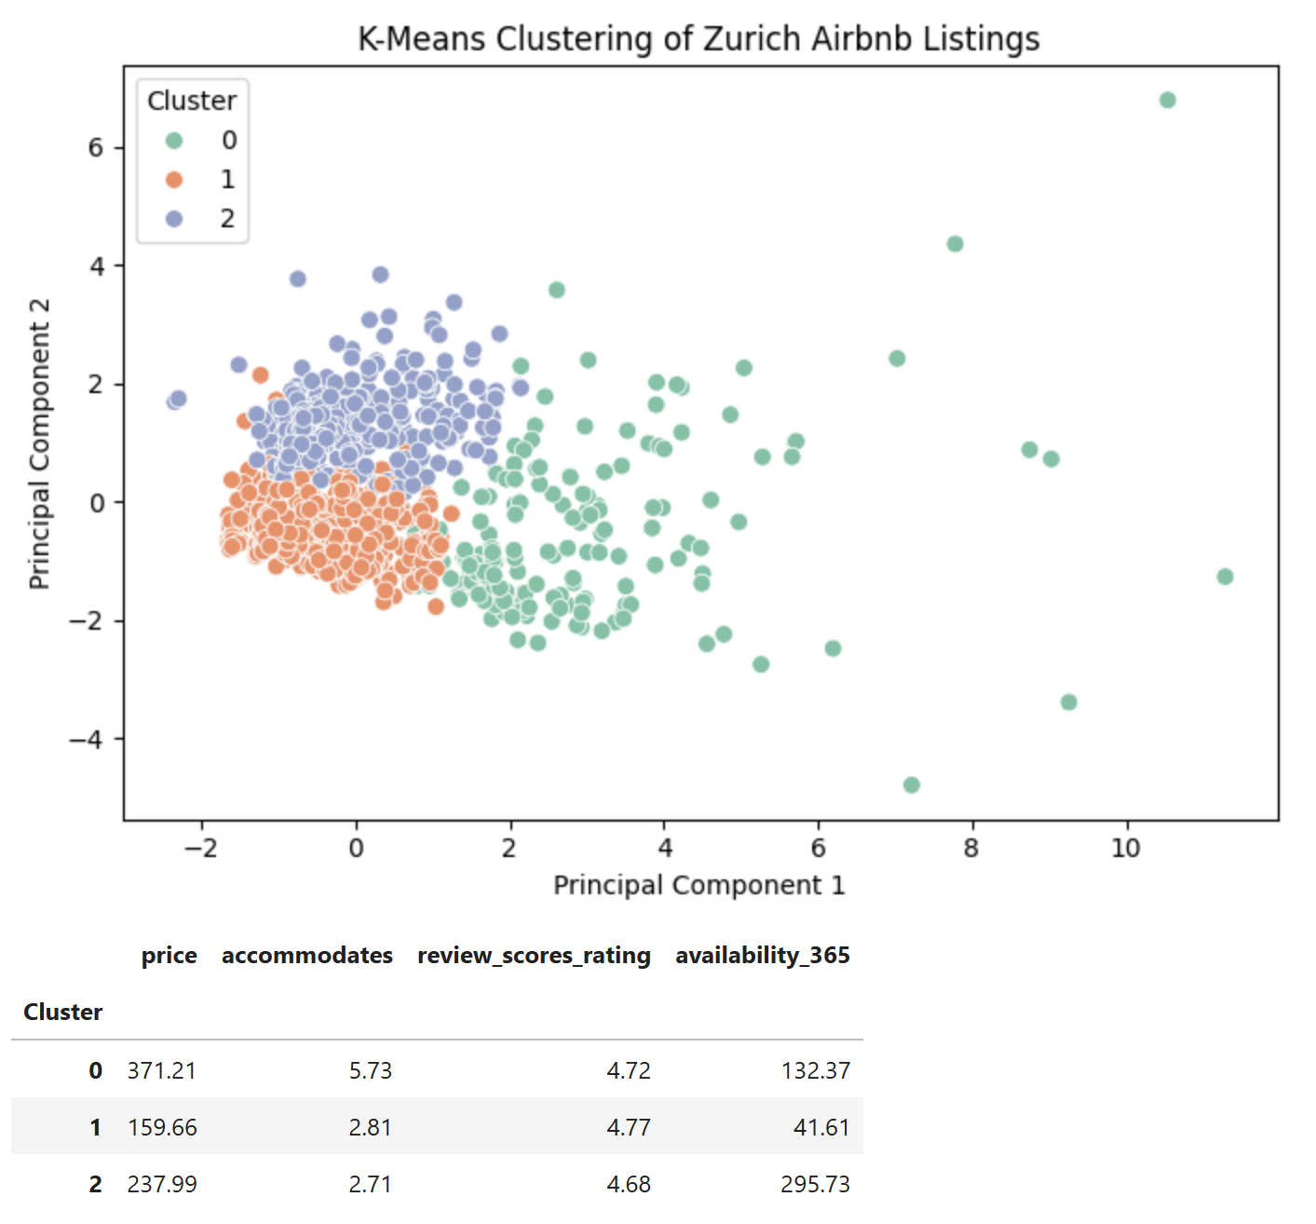
Clustering & Market Segments
Goal: Identify natural groupings in Zurich’s Airbnb listings.
3 clusters identified:
Luxury Central – high-priced, high-rated, low availability.
Budget Suburb – affordable, high availability, outer areas.
Balanced Comfort – mid-range, steady occupancy.
Clusters align with Zurich’s geography: structured, expensive in the centre, mellow toward edges.
Clusters reveal Zurich’s core divided into three markets: luxury near the lake, affordable outer areas, and balanced mid-range listings.

Slide 12
CONCLUSION
Summary This project analysed Zurich’s Airbnb listings to understand how pricing, language, and behaviour reflect market logic.
Insights • Size and amenities, especially bathrooms, drive price more than ratings. • Wi-Fi is nearly universal, setting a high baseline standard. • Host responsiveness links to experience and pricing confidence. • Text features like “modern” and “balcony” signal higher tiers. • Clusters revealed three market groups: luxury central, balanced mid-range, and budget suburban.
Reflection Zurich’s Airbnb market mirrors the city itself — precise, expensive, and quietly efficient.

Slide 13
Thank you

